Slide 1
Fall 2022 Follow-On Research
Mentor: Dr. Randy Napier
Student Researchers: Sofia Mollica-McCune, Uttaran Tribedi

Slide 2

Project overview and objective
The purpose of this follow-on research was to
continue generally pursuing our DHS/CAOE research agenda on SSCP cost-benefit analysis, and
prepare for Summer 2023 on-site data collection at Dallas-Fort Worth Airport and/or Dallas Love Field.
Notes:
Add summary of project

Slide 3


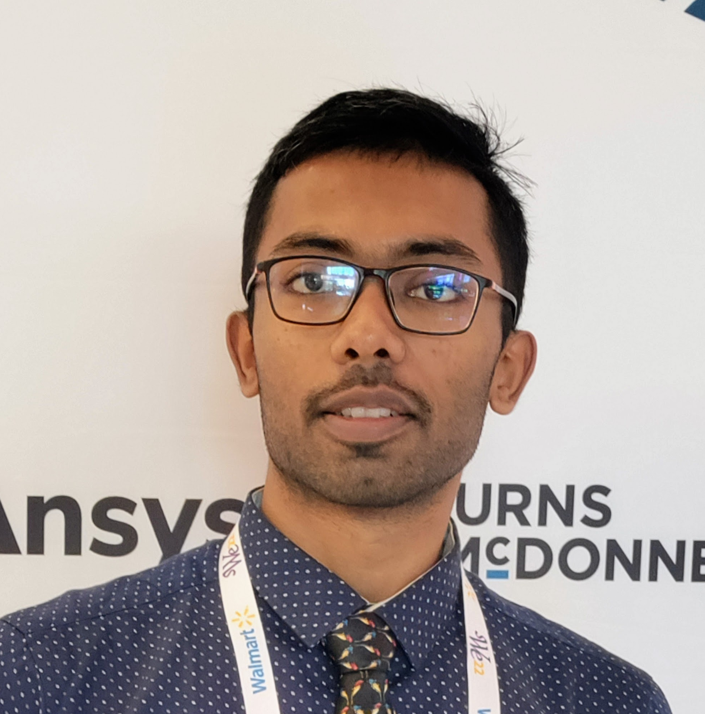
Research Team
Mentor: Dr. Randy Napier
Research Intern: Sofia Mollica-McCune
Research Intern: Uttaran Tribedi
Notes:
Add summary of project

Slide 4
Fall 2022 Research Progress
Interim effort to continue the DHS Summer 2022 Student Team Research
Prepare for work under the Follow-On Grant Proposal
UTA-funded GTA performed exploratory work on predictive modeling of passenger arrivals response to flight delays
The Follow-On Grant Proposal for the 2023 calendar year has been approved
The research agenda remains intact

Slide 5
Milestones
1. Successfully made connections for expanding research in the DFW metroplex for on-site survey data collection in 2023.
2. Deepened knowledge base and understanding of TSA SSCP processes
3. Designed a predictive flight delay model to help predict passenger arrivals in response to flight delays

Slide 6
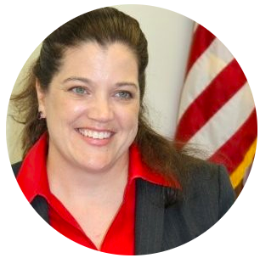

Milestone 1
Ms. Kriste Jordan-Smith
Director of TSA for DFW metroplex
Serves as contact point to conduct on-site SSCP data collection
Why this is important?
The survey will gather updated values for our SSCP Cost-Benefit Analysis
Will provide updated values for the VTTS of business versus personal travel for analysis of TSO scheduling and equipment configuration decisions.
This Photo by Unknown Author is licensed under CC BY-SA

Slide 7
Milestone 2
Deepened knowledge base and understanding of TSA/ Airport operations
Added citations and captured .pdf’s of additional relevant peer-reviewed journal articles
Identified additional relevant federal government data sources
Identified and downloaded relevant federal government reports
Identified and downloaded general business articles on airport, TSA, and security processes

Slide 8
Research Journey Objectives
Identification of additional validated survey questions
Confirmed need for research via peer-reviewed articles
Approaches to general CBA models
Breakeven, Net Present Value, Cash flow analysis, etc.
General research on predicting arrival rates in various settings
Outreach research
Materials to speed onboarding for future student researchers

Slide 9
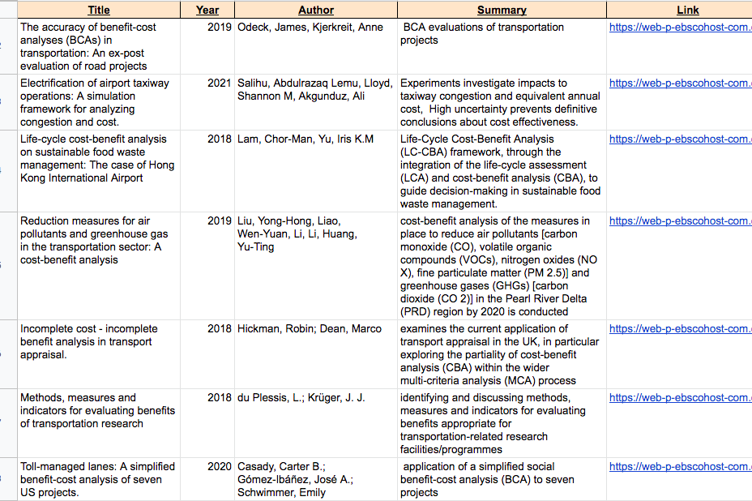
Notable CBA findings
The variation in the value of travel-time savings and the dilemma of high-speed rail in China
This paper examines the variation in the value of travel-time savings (VTTS), a fundamental element determining the market demand for various forms of transportation.
J. Zhao et al.The variation in the value of travel-time savings and the dilemma of high-speed rail in China. Transp. Res. A Policy Pract. (2015)

Slide 10
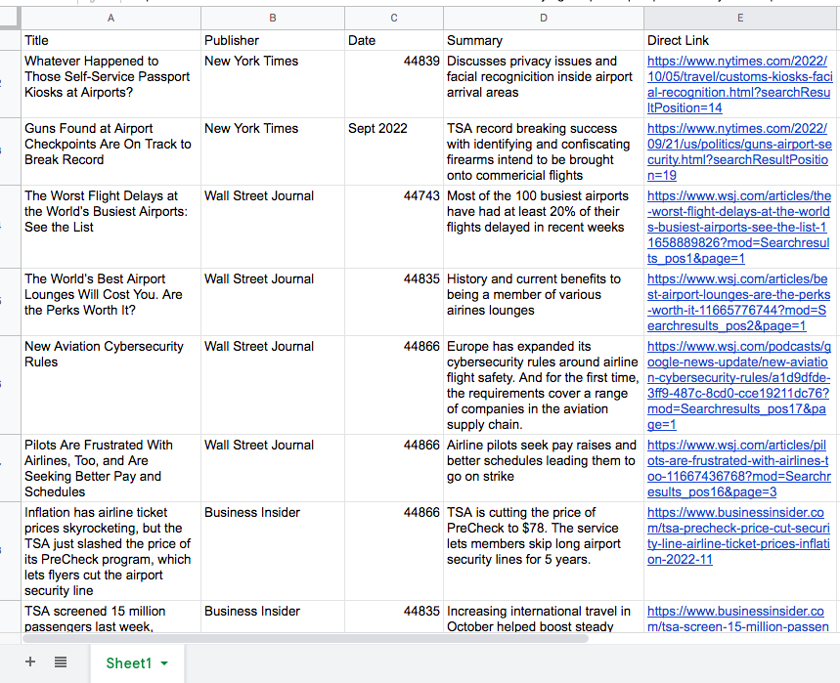
Notable TSA findings
How the TSA and airlines are trying to speed up airport security
TSA and airlines are turning to technology to try to speed things up.
Starting to test facial recognition for boarding and TSA checkpoints
https://www.cnbc.com/video/2021/11/24/how-the-tsa-and-airlines-are-trying-to-speed-up-airport-security.html?&qsearchterm=airport%20tsa

Slide 11
Milestone 3
Developed predictive models for flight delays to assist in estimating the arrivals of passengers at the SSCP given their flight was delayed
Establishing positive correlation between flight delays and passenger’s SSCP wait times
Factors contributing to greater flight delays would now also count as factors responsible for increase in the average dwell time of passengers in airports.
Identified factors and tested a wide variety of Machine Learning algorithms

Slide 12
Predictive Models
The models chosen to be applied were Decision tree model, Random Forest model, Gradient Boosting classifier model, voting classifier model and Logistic Regression model(with grid search CV for hyperparameter tuning).
The best metrics were shown by the Gradient Boost model which gave us a test accuracy score of 67%

Slide 13
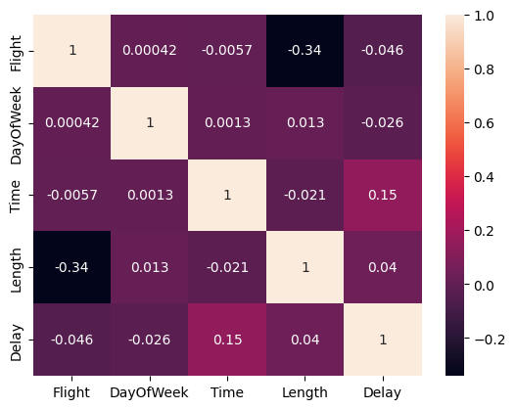
Factors causing delay (correlation matrix)

Slide 14
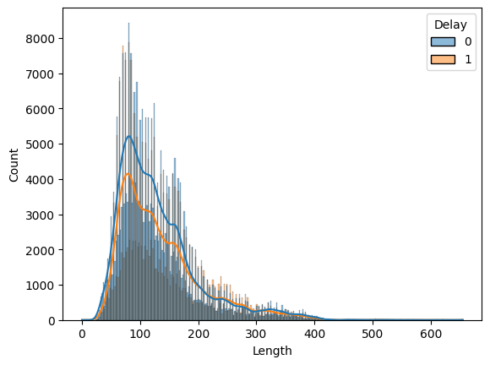
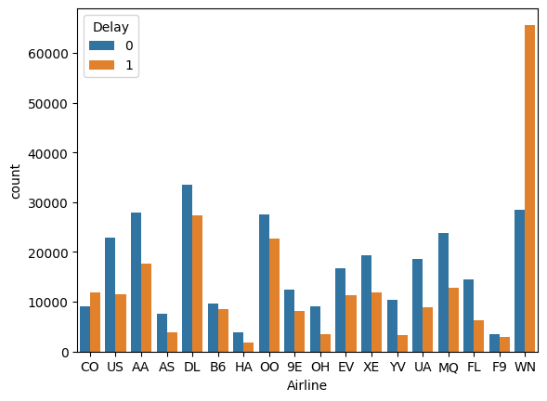
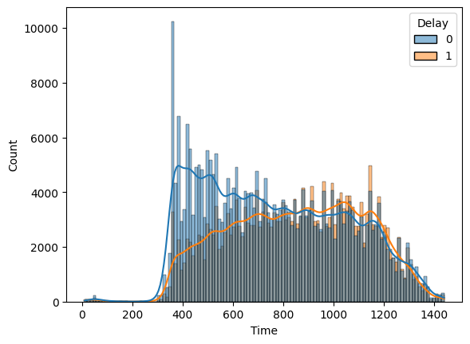
Insights into the dataset
Notes:
Feel free to add or delete as you need

Slide 15
Future scope—Predictive Models
Trying other models
More hyperparameter tuning with existing models to improve performance
Investigate more factors for airline delay
Search for better and more relevant datasets
Combining multiple datasets having relevant independent variables across same time period

Slide 16
Follow-on Proposal / Research Agenda
Extend and publish literature reviews on VTTS and Cost-Benefit Analysis for SSCP operations
Augment the VTTS and CBA models for DHS use and peer-reviewed publications
Proof-of-concept survey research on data capture for real-time VTTS estimation and real-time CBA
Notes:
RAN

Slide 17
Grant Acknowledgment
The material in this presentation is based upon work supported by the U.S. Department of Homeland Security under Grant Award Number, 17STQAC00001-05-03."
Disclaimer: The views and conclusions contained in this document are those of the authors and should not be interpreted as necessarily representing the official policies, either expressed or implied, of the U.S. Department of Homeland Security.

Slide 18
Fall 2022 Follow-On Research
Mentor: Dr. Randy Napier
Student Researchers: Sofia Mollica-McCune, Uttaran Tribedi

